Slide 1

Automated E-Certificate Generation with UiPath RPA
Discover how UiPath RPA streamlines e-certificate creation. This project automates customization using Excel data and PowerPoint templates. It ensures efficient, error-free certificate generation for various events and programs.

Slide 2

Data Source: Excel Integration
1
Read Excel File
The bot accesses an Excel file containing recipient information. Each row represents a unique certificate recipient.
2
Extract Data
Relevant details like names and achievements are extracted from the Excel rows. This data populates the certificates.
3
Prepare for Insertion
The extracted data is formatted and prepared for insertion into the PowerPoint template. This ensures consistency.

Slide 3
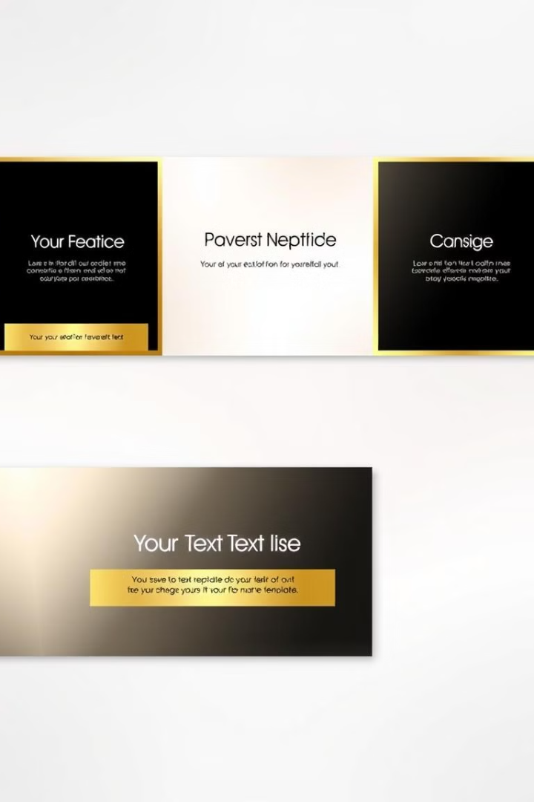
PowerPoint Template Utilization
Placeholder Setup
Dynamic Content
The template uses "MAD" as a placeholder. This marker indicates where recipient data will be inserted.
Placeholders can represent various data types like names or achievements. This flexibility allows for versatile certificate designs.
Template Reusability
A single template can generate multiple unique certificates. This approach saves time and ensures consistency.

Slide 4




Text Replacement Process
Identify Placeholder
Insert Data
Verify Replacement
The "Replace Text in Presentation" activity locates the "MAD" placeholder in the template. This step prepares for data insertion.
Excel data replaces the placeholder. The bot inserts the correct information for each recipient.
Options like "Match case" and "Replace all" ensure accurate and complete text replacement. This guarantees certificate quality.

Slide 5
Saving Personalized Certificates
File Naming
Save Activity
File Management
Each certificate is saved with a unique filename. This is typically based on the recipient's name or identifier.
The "Save PowerPoint File As" activity creates individual files. This preserves each personalized certificate separately.
Organized file saving facilitates easy distribution. It streamlines the process of sending certificates to recipients.

Slide 6

Looping Mechanism
1
Row-by-Row Processing
2
Continuous Operation
The bot iterates through each Excel row. This ensures every recipient receives a personalized certificate.
The loop runs until all data is processed. This allows for handling large volumes of certificates.
3
Efficiency at Scale
Automation enables rapid processing of numerous certificates. This is ideal for large events or programs.

Slide 7

Benefits of Automation
Aspect
Manual Process
Automated Process
Speed
Slow
Rapid
Accuracy
Prone to errors
Highly accurate
Scalability
Limited
Easily scalable
Consistency
Variable
Uniform

Slide 8




Applications and Future Enhancements
Academic Ceremonies
Automate certificate generation for graduations and academic achievements. This streamlines large-scale educational events.
Corporate Recognition
Generate certificates for employee awards and training completions. This enhances corporate recognition programs.
AI Integration
Future enhancements could incorporate AI for design suggestions. This would further automate the certificate creation process.

Slide 9
Cost-Benefit Analysis
Evaluating Expenses
Quantifying Benefits
Intangible Advantages
Return on Investment
Carefully assess the financial costs associated with the RPA implementation, including software licenses, infrastructure, and training requirements.
Determine the tangible benefits of automating the certificate generation process, such as reduced labor hours, improved efficiency, and increased accuracy.
Consider the non-financial advantages, like enhanced user experience, improved customer satisfaction, and increased employee morale.
Analyze the long-term ROI to ensure the RPA solution provides a favorable cost-benefit ratio and aligns with the organization's strategic objectives.

Slide 10
Integration Options
Excel Integration
Database Integration
API Integration
Cloud Storage Integration
Seamlessly connect the certificate generation process with existing Excel spreadsheets, enabling quick data imports and personalized certificate creation.
Leverage APIs to fetch data from various systems, ensuring the certificate generation process is dynamic and adaptable to changing requirements.
Integrate with a database to directly pull recipient information, streamlining the data sourcing and reducing manual data entry.
Enable secure storage and easy distribution of generated certificates by integrating with cloud storage platforms like Google Drive or Microsoft OneDrive.

